Slide 1


JSPM’s
RAJARSHI SHAHU COLLEGE OF ENGINEERING
Department of Electronics and Telecommunication Engineering
A
Project Presentation
on
“Driver Drowsiness Eye Detection System”
By
Devang Bhalerao
Suryansh Das
Sumeet Bonde
under the guidance of
Dr.P.M.Ghate

Slide 2
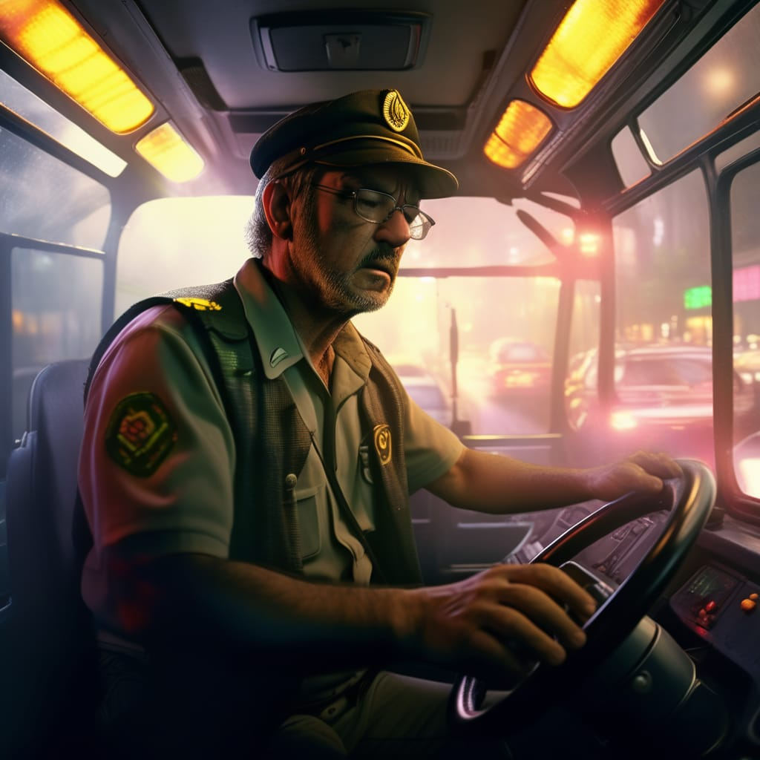
JSPM’s
RAJARSHI SHAHU COLLEGE OF ENGINEERING
Department of Electronics and Telecommunication Engineering
Contents:
Problem Statement
Introduction
Literature Review
Objectives
Proposed Block Diagram
Methodology
Expected Outcome
Libraries Used
Applications
References

Slide 3
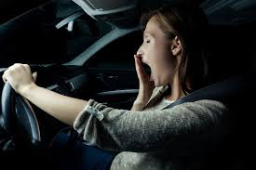
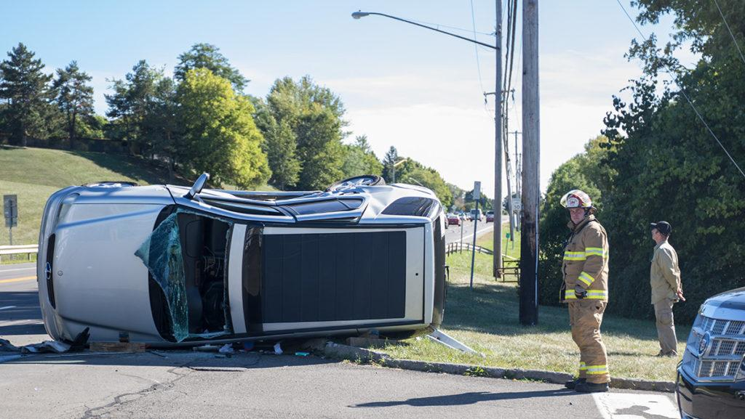
JSPM’s
RAJARSHI SHAHU COLLEGE OF ENGINEERING
Department of Electronics and Telecommunication Engineering
Problem Statement:
Drowsiness is commonly induced by a lack of sleep, certain medications, and boredom produced by driving a vehicle for extended periods of time.
The problem at hand is to develop an efficient and reliable Driver Drowsiness Detection System that can accurately identify signs of driver fatigue and alert the driver in real-time.
RAJARSHI SHAHU COLLEGE OF ENGINEERING

Slide 4
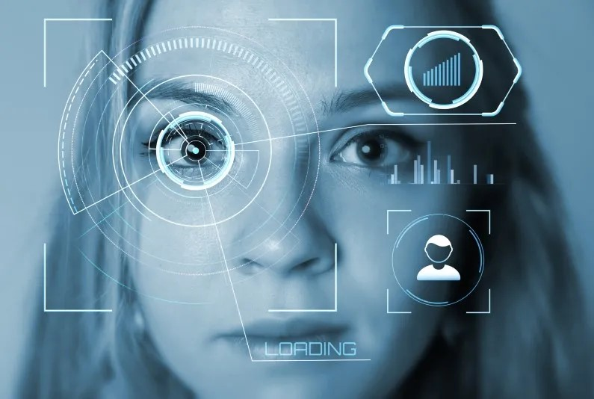
JSPM’s
RAJARSHI SHAHU COLLEGE OF ENGINEERING
Department of Electronics and Telecommunication Engineering
Introduction:
Driver Drowsiness Detection System is designed to monitor a driver's state and alert them if signs of drowsiness are detected. Various mechanisms can be employed to achieve this, and they often involve the use of sensors and algorithms to analyze the driver's behavior and physiological indicators.
Facial Recognition: Cameras can capture images of the driver's face and analyze facial features to detect signs of drowsiness, such as drooping eyelids or yawning.
Eye Tracking: By tracking the movement of the driver's eyes, the system can detect patterns associated with drowsiness, such as slow eye movements, frequent blinking, or prolonged closure of the eyes.
Auditory Alerts: Alarms or audible warnings can be triggered to alert the driver.

Slide 5
JSPM’s
RAJARSHI SHAHU COLLEGE OF ENGINEERING
Department of Electronics and Telecommunication Engineering
Literature Review :
Year of Publication | conference/ journal | Author | Method
15-17 June 2020 | Conference | Neel Desai ;Pratha Kulkarni; Lijin Joy; Prachi Raut, IEEE | IoT based Post Crash Assistance System
5-8 Aug. 2019 | Conference | Belal Alshaqaqi; Abdullah Salem Baquhaizel; Mohamed El Amine Ouis; Meriem Boumehed; Abdelaziz Ouamri; Mokhtar Keche; Driver drowsiness detection system | Vibration Sensor Based On Graphene-coated Excessively Tilted Fiber Gratin
7-9 Jan. 2018 | Conference | Tey Han Yee, Phooi Yee Lau (Centre for Computing and Intelligent Systems (CCIS), University Tunku Abdul Rahman, Malaysia) IEEE | Mobile vehicle crash detection system
7-9 April 2017 | Conference | Juber Mohamad Shaphi Mulla; Dipak Gavade ; Saylee Sandeep Bidwai;Sandeep S. Bidwai, IEEE | Research paper on airbag deployment and accident detection system for economic cars

Slide 6
JSPM’s
RAJARSHI SHAHU COLLEGE OF ENGINEERING
Department of Electronics and Telecommunication Engineering
Objectives :
Drowsiness Detection : Develop an algorithm that analyzes the data from the sensor to identify signs of drowsiness, such as prolonged eye closures or erratic blink patterns.
Data Collection : The eye blinking sensor continuously monitors the driver's blink patterns.
User Interaction : Consider adding a manual override or a button for the driver to disable the system when needed.
Alert System : When drowsiness is detected, activate the warning system.
Testing and Safety : Ensure the system is safe for use in a moving vehicle. Test it extensively to avoid false alarms or any safety concerns.

Slide 7
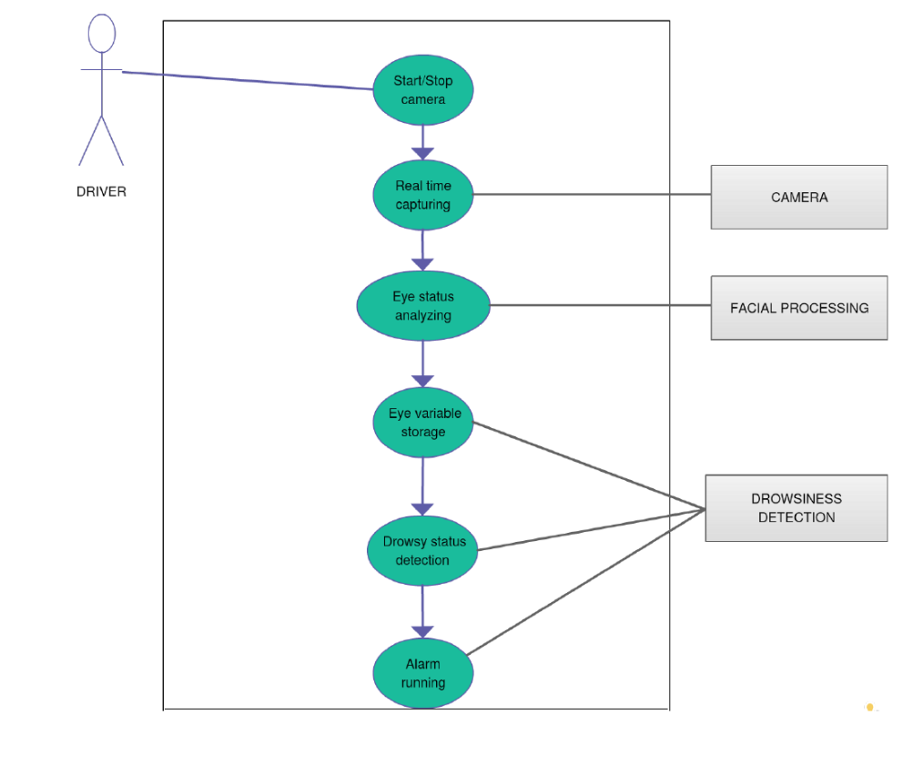
JSPM’s
RAJARSHI SHAHU COLLEGE OF ENGINEERING
Department of Electronics and Telecommunication Engineering
Proposed Block Diagram:

Slide 8
JSPM’s
RAJARSHI SHAHU COLLEGE OF ENGINEERING
Department of Electronics and Telecommunication Engineering
Methodology:
Step 1:
So we’ll install all our dependencies in this step. We’re going to use OpenCV for computer vision, Dlib library for facial recognition, and also the Imutils package to use some functions that will help us convert the landmarks to NumPy array and make it easy for us to use.
Step 2:
Initialize and read from the webcam.
Step 3:
Facial Landmark Detection using dilib Facial landmarks are the key attributes of a face in an image like eyes, eyebrows, nose, mouth, and Jaw.
Now the question arises, how are we going to use these landmarks for eye detection.

Slide 9
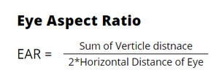
JSPM’s
RAJARSHI SHAHU COLLEGE OF ENGINEERING
Department of Electronics and Telecommunication Engineering
Eye Landmarks:
We saw that we can extract any facial structure from the 68 Facial Landmarks that we detected. So, we’ll extract the landmarks of the eyes i.e 6 (x,y) coordinates for each eye, for any given face in an image. And then we’ll calculate the EAR for these landmarks.
Eye Aspect Ratio (EAR) :
This method is very simple, efficient, and doesn’t require anything like image processing. Basically, this ratio gives us a certain relation between the horizontal and vertical measurements of the eye. This is the equation to calculate the EAR using the six parameters of the eye :

Slide 10
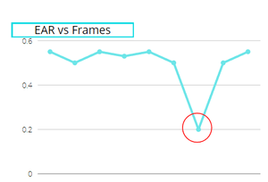
JSPM’s
RAJARSHI SHAHU COLLEGE OF ENGINEERING
Department of Electronics and Telecommunication Engineering
This is the most important part, when you calculate the EAR of an eye, it remains constant when the eye is open but it suddenly drops when the eye is blinked. Below, I have shown a graph to show it’s working:
As you can see in the image the overall value of EAR was constant throughout except at one point i.e when the eye is blinked, making it one of the most simple and most efficient ways of detecting an eye blink.

Slide 11
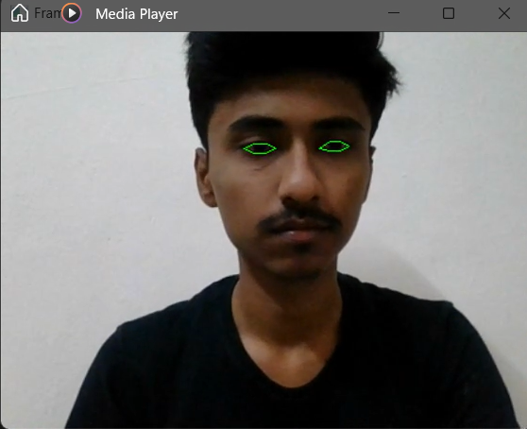
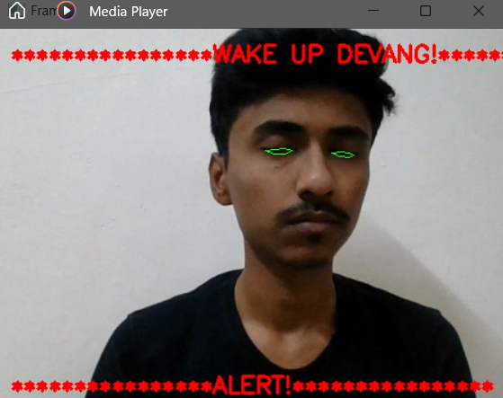
JSPM’s
RAJARSHI SHAHU COLLEGE OF ENGINEERING
Department of Electronics and Telecommunication Engineering
Expected Outcome:
we come up with two conditions:
When there is not much action in the eye which makes the value of EAR constant, the camera doesn’t disturb the user until any movement.
When there is a slight change in the value of EAR while monitoring, the program alerts the user regarding change in movement.

Slide 12
JSPM’s
RAJARSHI SHAHU COLLEGE OF ENGINEERING
Department of Electronics and Telecommunication Engineering
Librarys Used :
OpenCV
detect all the faces, Image processing library
Dilib
detect size of face by landmark face detector
Numpy
optimizied numerical operation
Pygame &Mixer
we can actully play music/audio files
Imutiles
basic image processing functions such as sorting contours & detecting edges.

Slide 13
JSPM’s
RAJARSHI SHAHU COLLEGE OF ENGINEERING
Department of Electronics and Telecommunication Engineering
APPLICATIONS:
The system can be made more accurate using various other parameters such as State of the Car, Detecting Foreign Substances on Face etc.
We can be developed where it can alert or prevent the user from sleeping.
It can be used to develop an IOT device that can be installed in the car to detect driver’s drowsiness.
Similar models and techniques can be used for various other uses such as Netflix, Hotstar and other streaming service platforms can detect whether the person is sleeping and stop the video accordingly

Slide 14
JSPM’s
RAJARSHI SHAHU COLLEGE OF ENGINEERING
Department of Electronics and Telecommunication Engineering
References:
A. M. Malla, P. R. Davidson, P. J. Bones, R. Green and R. D. Jones,” Automated video-based measurement of eye closure for detecting behavioral microsleep” 2010 Annual International Conference of the IEEE Engineering in Medicine and Biology, Buenos Aires, 2010. DOI: 10.1109/IEMBS.2010.5626013.
Gopal and V. . Vineeth, “Driver Drowsiness Detection System,” International Journal of Advances in Electronics and Computer Science, Vol. 4, No. 3, pp. 101–104, 2017.
S. Podder and S. Roy, “Driver’s drowsiness detection using eye status to improve the road safety,” International Journal of Innovation Research in Computer and Communication Engineering, Vol. 1, No. 7, 2013.

Slide 15
JSPM’s
RAJARSHI SHAHU COLLEGE OF ENGINEERING
Department of Electronics and Telecommunication Engineering
Thank You

